Slide 1
2 - Devops
Docker
By Hugo Lachkar

Slide 2
01
02
03
04
05
06
What is docker ?
What is docker-compose ?
Apache web server
Activity docker apache server
Node web server
Activity docker Node server

Slide 3
What is Docker ?

Slide 4
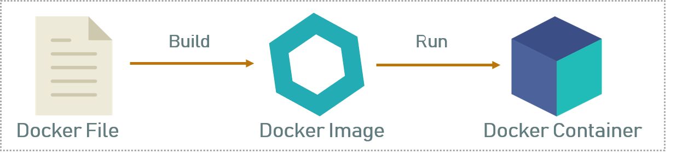

Slide 5
What is Docker-compose ?

Slide 6
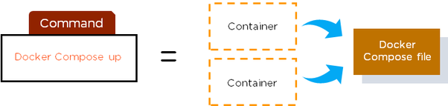

Slide 7
Apache
web server

Slide 8
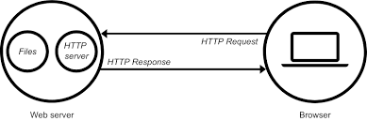

Slide 9
Install
Docker + Docker-compose

Slide 10
Activity Docker apache server

Slide 11
Node web server

Slide 12
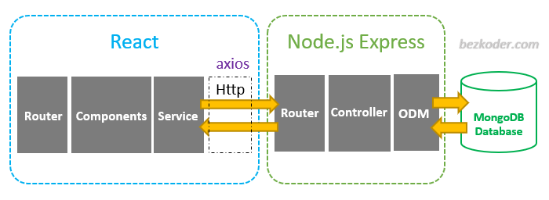

Slide 13
Activity Docker Node server

Slide 14
THANKS
Does anyone have any questions?
hugo1.lachkar@epitech.eu
hugolachkar.com

